Slide 1
Example Evening Monday Night January 2023 Giffnock Courts

Slide 3
Sample Evening Monday Night January 2024 Giffnock Courts

Slide 5
Example Evening Monday Night January 2024 Cowan Park Courts

Slide 6
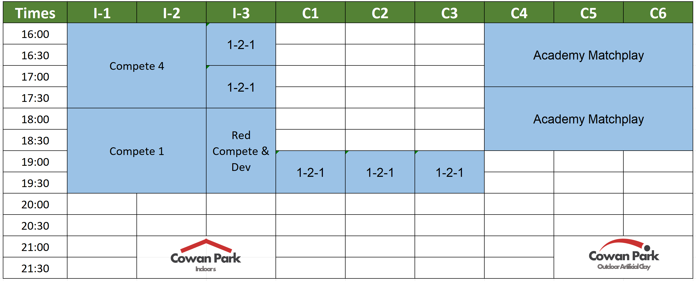

Slide 7
Free Capacity (4-10pm)
January
Monday
Night
25hrs
(⬆11hrs)
24hrs
(⬆24hrs)
6hrs
(⬆6hrs)
Cowan Park
Outdoor Artificial Clay
Cowan Park
Indoor s
307%
greater court availability
What That Could Mean to Members?
Capacity To Enter One or Two Monday Night
Winter League Teams
Up to 12 members per week could play winter league
Individual Lessons Get Full Courts
8 & Under Winter Sessions on Indoor Courts
Improves retention as young beginners struggle most with weather
Six Indoor Court Evening Hours For Member Booking
36 Members could play indoor doubles when weather is worst

Slide 8
Example Evening Friday Night June 2023 Giffnock Courts

Slide 10
Example Evening Friday Night June 2024 Giffnock Courts

Slide 12
Example Evening Friday Night June 2024 Cowan Park Courts

Slide 13
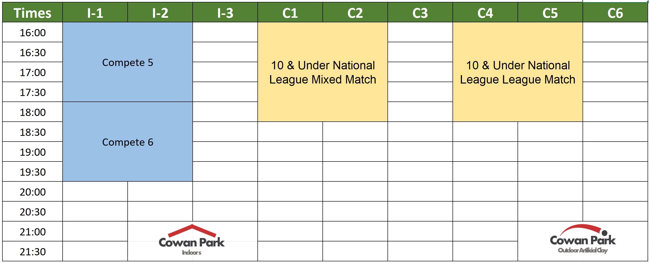

Slide 14
Free Capacity (4-10pm)
June
Friday
Night
24.5hrs
(⬆11hrs)
26hrs
(⬆26hrs)
10hrs
(⬆10hrs)
Cowan Park
Outdoor Artificial Clay
Cowan Park
Indoor s
348%
greater court availability
What That Could Mean to Members?
Removes Pressure Created by West League Matches
Massive increase in available courts
Team Training Could Continue During Summer Season
Currently there are no practices in season – players cant practice in season
Ability to Enter Girls Teams in Addition to Mixed Team
Provide equal team opportunity to both boys and girls to play for Giffnock
Box Leagues & Social Events
Extend our internal competitive offering to members beyond our team players

