Slide 1
Proposed expansion of Giffnock Tennis Squash & Hockey Club to incorporate a 2nd tennis campus, with improved playing facilities, at Cowan Park
AGM Proposal – February 2023

Slide 2
Background
The club committee continually assess opportunities to improve facilities for members. A key current focus is on provision of more court time for member bookings
Last year's AGM we approved two projects to development additional facilities
Unfortunately, the bowlers rejected our Padel court proposal in the car park in front of our building
Our long-term objective remains to upgrade the existing site in Giffnock with a new clubhouse designed in a manner which would potentially enable improved and additional sporting facilities

Slide 3
Cowan Park Opportunity
East Renfrewshire Council (ERC) has a statutory obligation to provide tennis at its Cowan Park site which it is currently unable to fulfil.
East Renfrewshire Council are willing to pass responsibility for the tennis courts at Cowan Park to Giffnock Tennis Squash & Hockey Club following a comprehensive assessment of our capability to deliver a programme compliant with ERC's statutory obligation, and on the recommendation of Tennis Scotland.
Tennis Scotland are willing to support delivery of tennis coaching, schools support and LTA sanctioned competitions at Cowan Park through creation of a Tennis Academy.
The proposed arrangement between the parties provides the land at Cowan Park to Giffnock on a Community Asset Transfer or a peppercorn rent for at least 25 years, grant funding in excess of £260,000 and substantial interest free LTA loan funding to upgrade the Cowan Park site

Slide 4
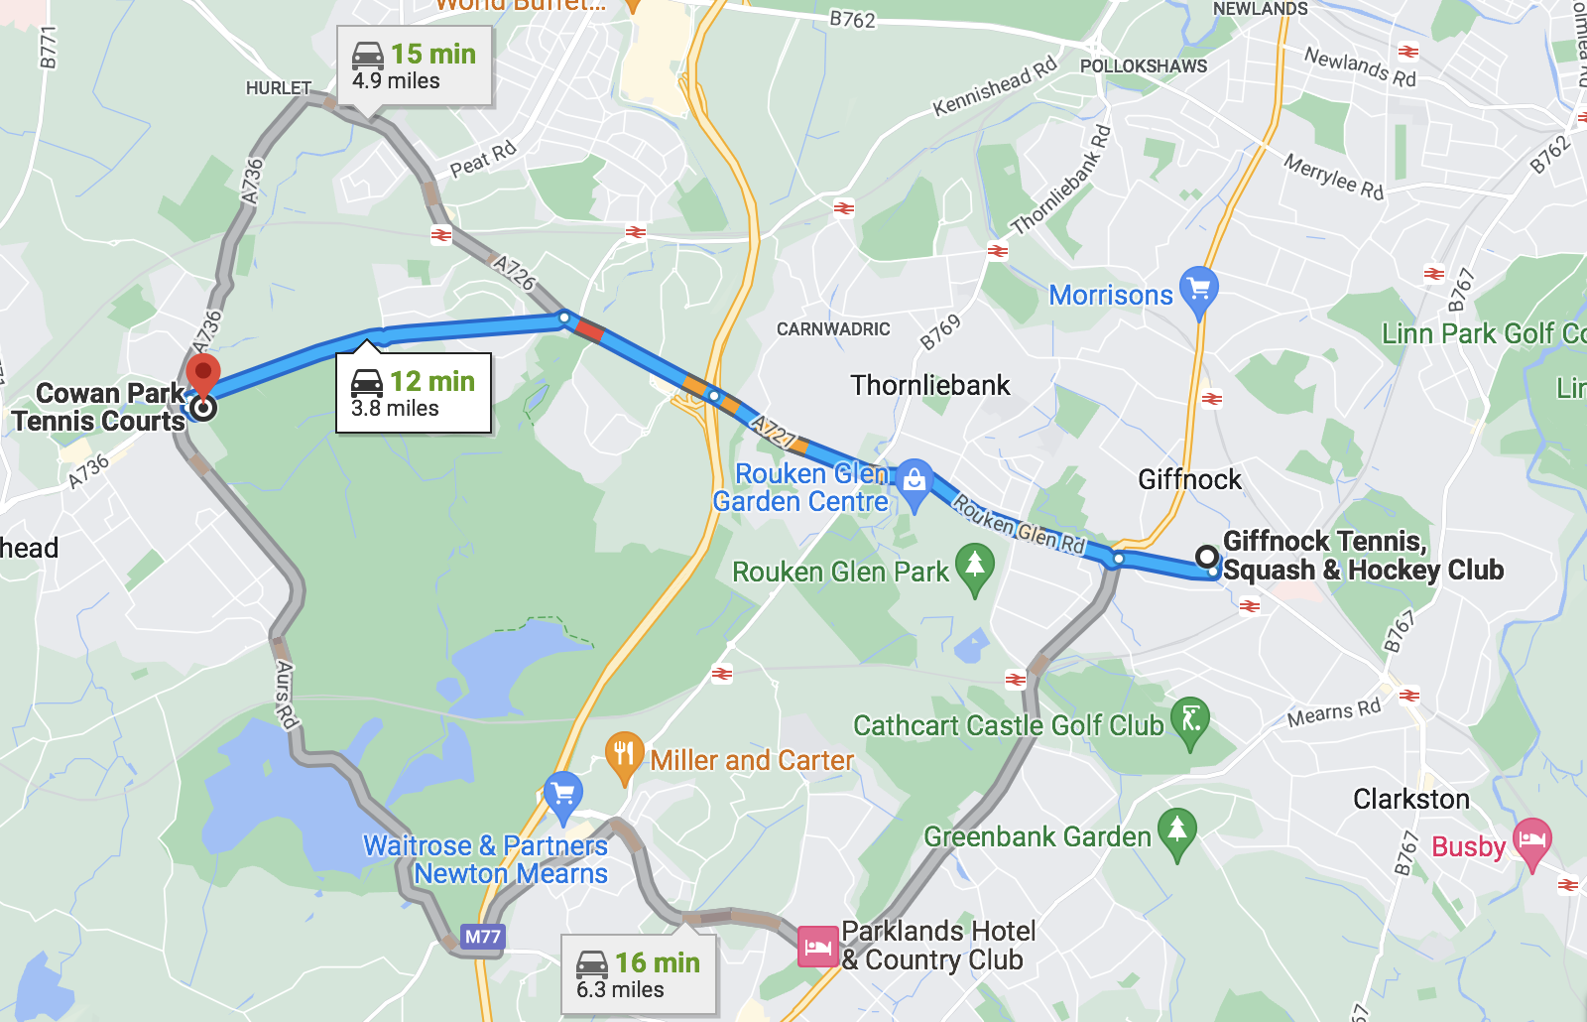
Cowan Park Location

Slide 5
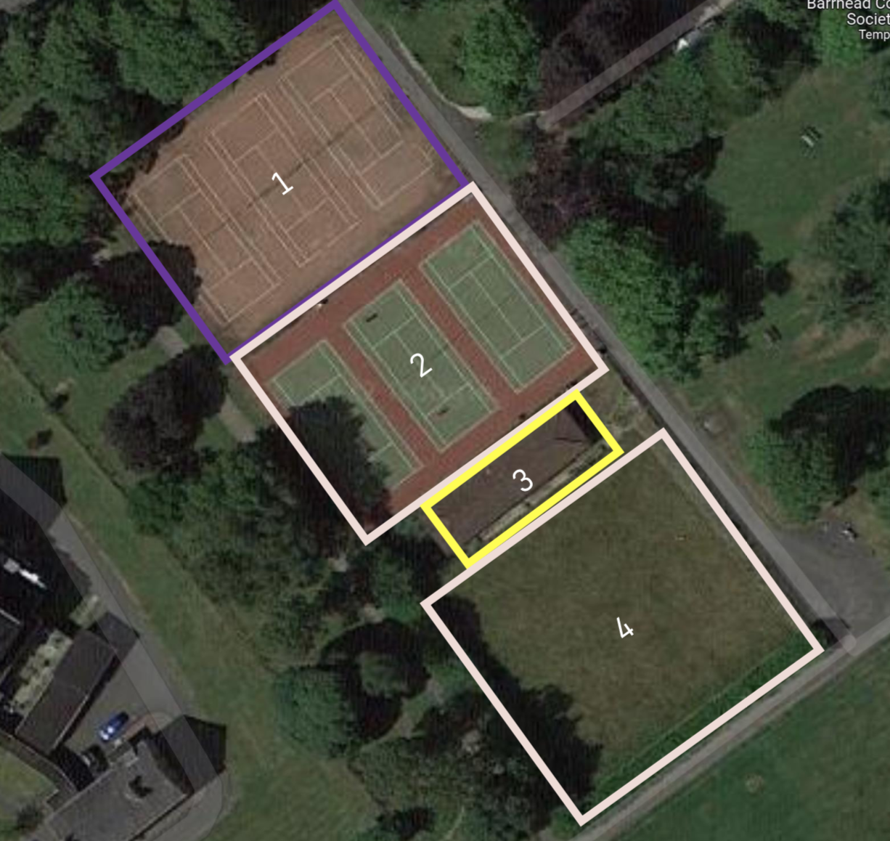
Cowan Park Site
3 existing blaes tennis courts that are no longer in use and no longer maintained/supported due to lack of play.
3 porous tarmacadam tennis courts upgraded by Tennis Scotland/Sportscotland circa 2010. Current court surface is dangerous for play in the wet.
The clubhouse of a former bowling club which closed down in 2019.
A disused bowling green

Slide 6
Why? – Key benefits of this proposal
It significantly increases court time available to Giffnock members at Percy Drive. We will move parts of our junior performance programme to Cowan Park (approx. 60% of midweek junior coaching between 4pm and 7pm)
Giffnock members will have access to an additional 6 outdoor tennis courts, intended to be surfaced with artificial clay (free to members other than charges for floodlight use)
Provides access to 3 indoor tennis courts (at a discounted rate to members)
Provides significant contribution to club finances - projected initial site surplus of £45,000, rising to £91,000 per annum when all loans are repaid
Notes:
This will give members of the club access to 3 surfaces

Slide 7
How is it financed?
*LTA Park Fund Grant Funding for Cowan Park public courts until the end of April 2023 | >£160k
*Sportscotland SFF Grant Funding indoor courts | £100k
Interest free LTA quick access loan(s) | £600k
Cash investment by the club | Up to £250k
Total | £1,110k
* denoted grant funding that is not repayable by Giffnock

Slide 8
Upgrading of Outdoor Tennis Courts
East Renfrewshire Council and the LTA propose to sign contracts to upgrade the 3 lower-level courts to porous tarmacadam and to install new fencing.
All 6 existing courts then transferred to Giffnock TSH under a Community Asset Transfer or on a peppercorn rent on a lease of not less than 25 years
Giffnock then upgrades the surface to artificial clay and installs floodlights.
New gates and electronic gate access system installed by the LTA to control access and monitor use.

Slide 9
Indoor Tennis Centre
East Renfrewshire Council transfer to Giffnock TSH the clubhouse and land of the former Cowan Park Community Bowling Club on a Community Asset Transfer or at a peppercorn rent. LTA Funding requires that any lease be for not less than 25 years to enable loan funding
Giffnock TSH deliver an indoor tennis centre that provides 3 indoor acrylic tennis courts, in sports hall construction, with integrated clubhouse facility.

Slide 10
Post Upgrade
Upgraded to artificial clay and floodlit
Upgraded to artificial clay and floodlit
3 court indoor tennis centre with integrated clubhouse
Note
Existing courts upgrade to include new fencing and wheelchair accessible gates with keypad door entry system installed with LTA Clubspark integration

Slide 11
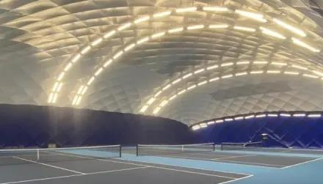
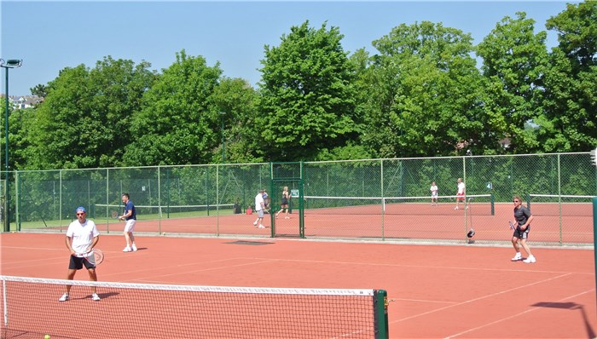
Visual Impressions
Tennis Hall
Clay Courts

Slide 12
The Motion Summary
Members are asked to approve the club enters secures the Cowan Park site under a Community Asset Transfer or lease in order that new and improved facilities are available to members.
This will enable the management committee to:
Take on the site under a Community Asset Transfer or to sign lease(s) for the Cowan Park site (any lease to be for a term of not less than 25 years)
Deploy, in partnership with Tennis Scotland, grant funding before the April cutoff date
spend up to £250k of club cash reserves to deliver the project
enter into interest free LTA loans secured solely against the Cowan Park site
appoint contractors to carry out works

Slide 13
Appendices

Slide 14
Indicative Costs
£750,000 fixed price contract with LTA Approved Contractor for 3 court indoor tennis centre
£110,000 fixed price contract with LTA Approved Contractor for surfacing of 6 courts in artificial clay
£50,000 for installation of floodlights to outdoor courts
£200,000 groundworks, installation of porous tarmacadam, fencing, gate access and LTA control systems

Slide 15
Annual net profit / loss
Annual Revenue
Phase 1: Outdoor booking revenue | 1,092
Phase 1: Outdoor floodlight hire | 4,962
Phase 1: Giffnock squad moves | 5,472
Phase 1: Additional tournament income | 25,600
Phase 1: Season ticket holders | 4,800
Phase 2: Indoor booking revenue | 114,750
Total | 156,676
Annual Loan Costs
Phase 1: LTA Loan Repayment (outdoor) | 15,800
Phase 2: LTA Loan Repayment (indoor) | 29,467
Total | 45,267
Annual Running Costs (including sinking funds)
Phase 1: Nominal fee for land rent | 1
Phase 1: Outdoor lighting | 2,858
Phase 1: LTA Annual Venue Registration | 760
Phase 1: Public Court Coaching | 3,400
Phase 1: Tournament costs | 9,437
Phase 1: Outdoor Courts Sinking fund | 12,600
Phase 1 & 2: Clubhouse Cleaning & Utilities | 5,460
Phase 1 & 2: Rates, Water and Insurance | 3,200
Phase 1 & 2: Strip payment fees | 1,122
Phase 1 & 2: Tennis balls& equipment for coaching on site | 1,500
Phase 1 & 2: Cowan Park building & grounds maintenance costs | 2,401
Phase 1 & 2: Administration costs | 5,000
Phase 2: Indoor lighting | 6,378
Phase 2: Indoor Tennis courts sinking fund | 12,000
Total | 66,117
Annual net profit / loss (while the loans are being repaid) | 45,293
Annual net profit / loss (following loan repayments) | 90,559
Notes
The opportunity is expected to generate more than double the running costs once the loans are repaid

Slide 16
Break Even Analysis
Notes
The club is projected to recover the initial cash investment in year 8 (2030) before the sinking fund is committed to relay the courts

